Slide 1
GNANAMANI COLLEGE OF TECHNOLOGY SMART ANTENNAS
Presented by
S.Jeevitha
III- ECE

Slide 2
Smart Antennas
The presentation is divided into the following:
Why?
What?
How?

Slide 3
Why Smart Antennas?
Large increase in Capacity
Increased range
Potential to introduce new services
More security
Reduced Multipath propagation

Slide 4
What are Smart Antennas?
In a cellular system the radio communication is between the user and a base station, which provides radio coverage within a certain area, called a cell.
The base stations are omni directional or sectored.
This is a waste of power as most of it will be radiated in other directions than toward the user.
The power radiated in other directions will be experienced as interference by other users.

Slide 5
What are Smart Antennas (SA)?
The idea of smart antennas is to use base station antenna patterns that are not fixed, but adapt to the current radio conditions.
This can be visualized as the antenna directing a beam toward the communication partner only.

Slide 6
Illustration of Smart Antennas

Slide 7
Sharing the Radio Spectrum
Users communicating via the same base station
have been separated in various ways:
- by frequency as in FDMA ( frequency division multiple access),
- by time as in TDMA ( time division multiple access),
- by code as in CDMA ( code division multiple access) and
- by space through SDMA ( space division multiple access) in smart antennas.

Slide 8
The Concept
Smart Antenna consists of a number of radiating elements, a combining/dividing network and a control unit.
Control unit can be called the smart antenna’s intelligence. It is realized using a digital signal processor (DSP).
Based on this definition of smart antenna, one can define “levels of Intelligence”.

Slide 9
Evolution of Smart Antennas
An evolution can be foreseen in the utilization of smart antennas. The evolution can be divided into three phases:
- Smart antennas are used on uplink only. This concept is called high sensitivity receiver (HSR).
- In the second phase, directed antenna beams are used on the downlink direction in addition to HSR.
- The last stage in the development will be full space division multiple access (SDMA).

Slide 10
Drawbacks and Cost factors
Transceiver Complexity -- A smart antenna transceiver is much more complex than a traditional base station transceiver.
- Need for more powerful algorithms, processors and control systems.
Resource Management -- New demands on network functions such as resource and mobility management are needed.
Physical Size -- For the smart antenna to obtain a reasonable gain, an array antenna with several elements is necessary.

Slide 11
Status: Trials and Testbeds
Ericsson/Mannesmann Trial in Giessen, Germany
Tsunami II Trial in Bristol, UK

Slide 12
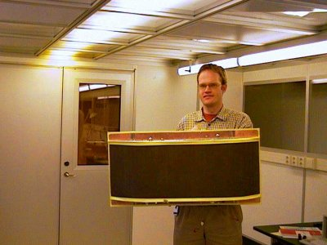
Picture of an 8-element array antenna
at 1.8 GHz. (Antenna property of Telia Research AB, Sweden).

Slide 13
Thank You!

